Slide 1
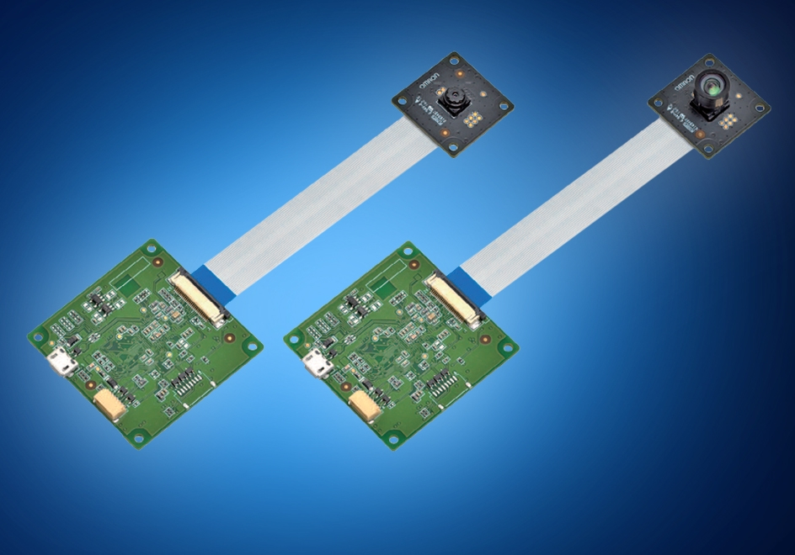
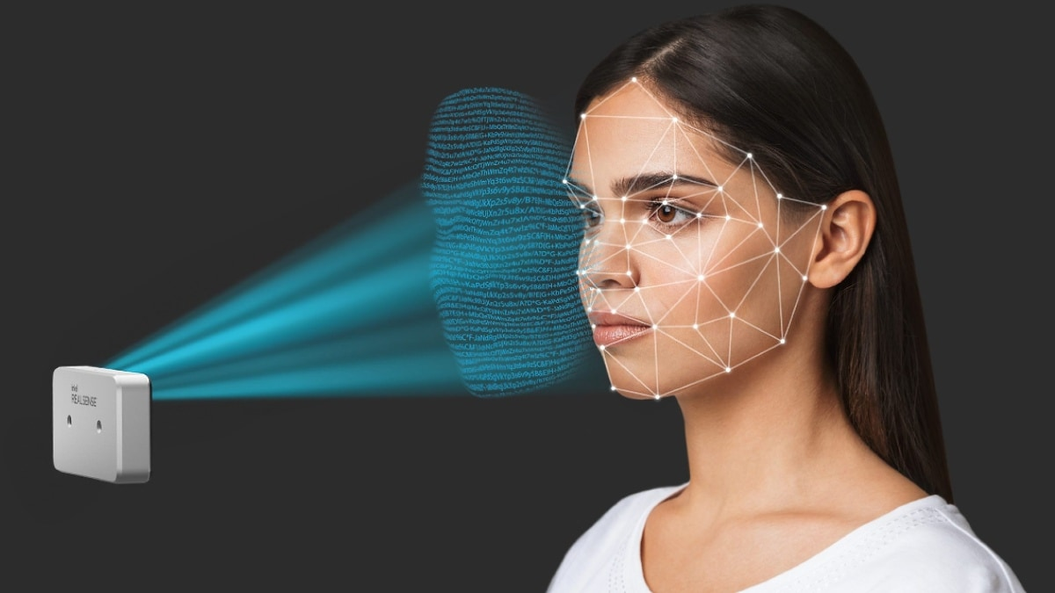
Face Detection Sensor

Slide 2
Presented by:
Debodipto Samadder
ID: 21201079
Roll: 79
Section: B
Department of CSE,
University of Asia Pacific.

Slide 3
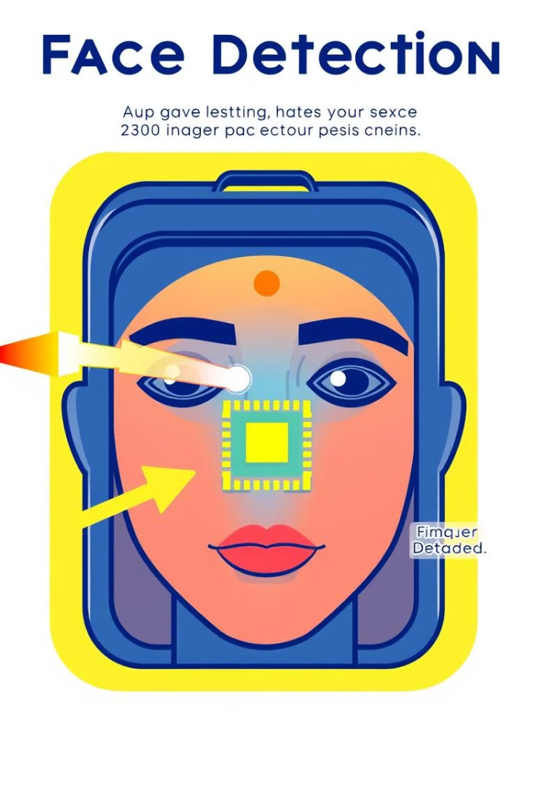
How Do Face Detection Sensors Work?
1
Image Capture
The sensor captures a digital image or video frame containing one or more human faces.
2
Face Localization
The system analyzes the image to identify and locate the position of any faces present.
3
Feature Extraction
Unique facial features, such as eyes, nose, and mouth, are extracted and analyzed to identify the face.

Slide 4
Applications of Face Detection Sensors:
Security and Surveillance:
User Authentication:
Targeted Advertising:
Face detection sensors can be used for identity verification, access control, and monitoring in security and surveillance systems.
Face detection enables biometric authentication for secure login, transaction verification, and device unlocking.
Face detection can be used to analyze consumer demographics and personalize advertising content for maximum engagement.

Slide 5
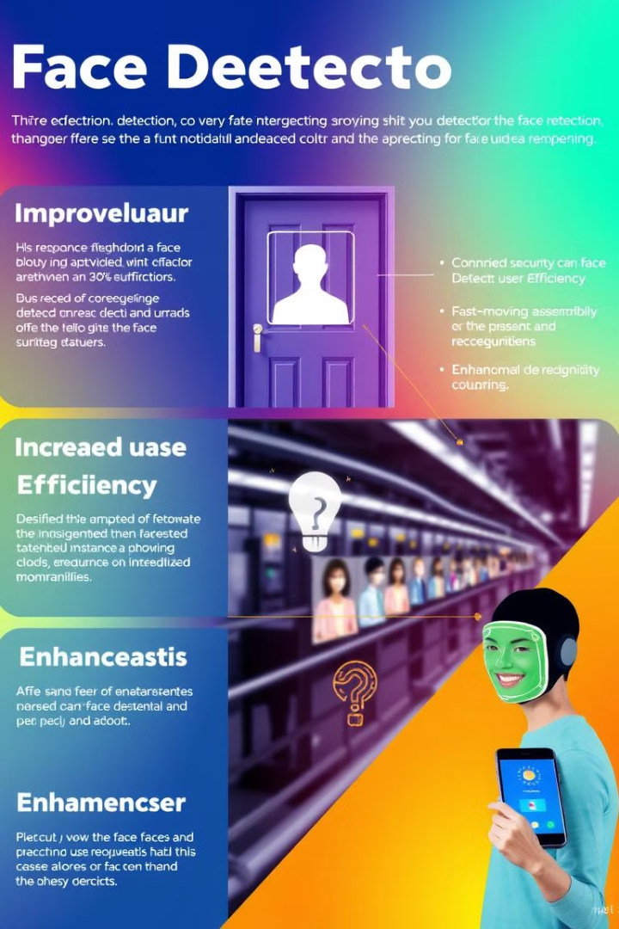
Advantages of Face Detection Technology
1
Improved Security
2
Increased Efficiency
Face detection enhances security by enabling accurate identification and access control, reducing the risk of unauthorized entry or impersonation.
Automated face detection can streamline processes, reduce manual intervention, and improve the overall efficiency of various applications.
3
Enhanced User Experience
Face detection technology can provide a more seamless and personalized experience for users, such as in authentication, targeted advertising, and surveillance systems.

Slide 6

Challenges and Limitations
Lighting Conditions
Facial Occlusion
Face detection sensors can be affected by changes in lighting, which can impact the accuracy and reliability of the system.
The presence of objects or accessories that partially obscure the face can hinder the sensor's ability to detect and identify individuals.
Diversity in Facial Features
Face detection algorithms may struggle to accurately identify faces with diverse characteristics, such as different ethnicities, ages, or genders.

Slide 7




Ethical Considerations in Face Detection
Privacy
The widespread use of face detection technology raises concerns about individual privacy and the potential for misuse or abuse of personal data.
Bias
Face detection algorithms may exhibit biases, leading to inaccuracies or disproportionate impacts on certain demographic groups.
Transparency
It is crucial to ensure that the development and deployment of face detection sensors are transparent and subject to appropriate oversight and regulation.

Slide 8
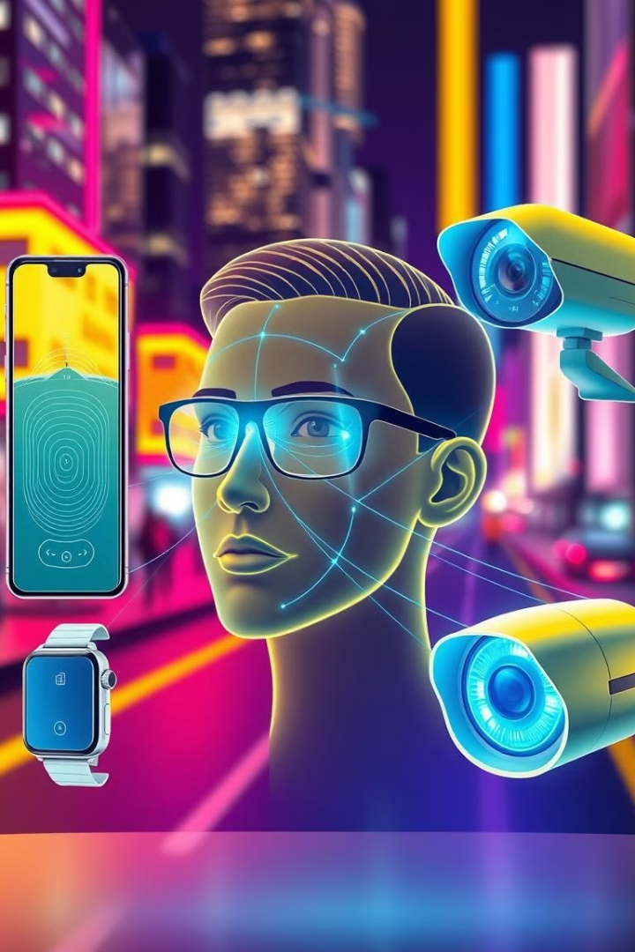
The Future of Face Detection Sensors
1
Improved Accuracy
Ongoing research and development will enhance the accuracy and reliability of face detection algorithms, addressing current limitations.
2
Expanded Applications
Face detection sensors will continue to be integrated into a wide range of applications, from security and authentication to personalized user experiences.
3
Ethical Safeguards
Policymakers and industry leaders will work to establish ethical guidelines and regulatory frameworks to ensure the responsible use of face detection technology.

Slide 9
Key Takeaways
1
Powerful Technology
2
Diverse Applications
3
Ethical Considerations
Face detection sensors leverage advanced computer vision and machine learning to rapidly identify and analyze human faces.
These sensors have a wide range of applications, from security and authentication to targeted advertising and personalized user experiences.
The use of face detection technology raises important privacy and bias concerns that must be addressed through responsible development and deployment.

Slide 10
Thank You

